Slide 1
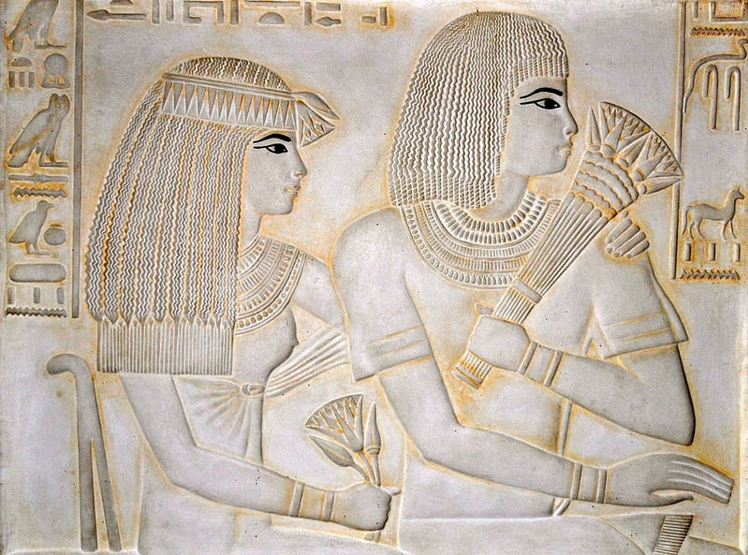
📚 HerStory Guide Chatbot
AI chatbot exploring women's history and feminism
Peseshet (c. 2500 BCE) — “Lady Overseer of the Female Physicians”Peseshet is considered one of the earliest documented female physicians in history.She lived in Ancient Egypt more than 2000 years before classical Greek medicine.I chose this image to open the presentation because it reminds us that women were involved in medical knowledge long before the traditions that later shaped modern Western medicine.

Slide 2
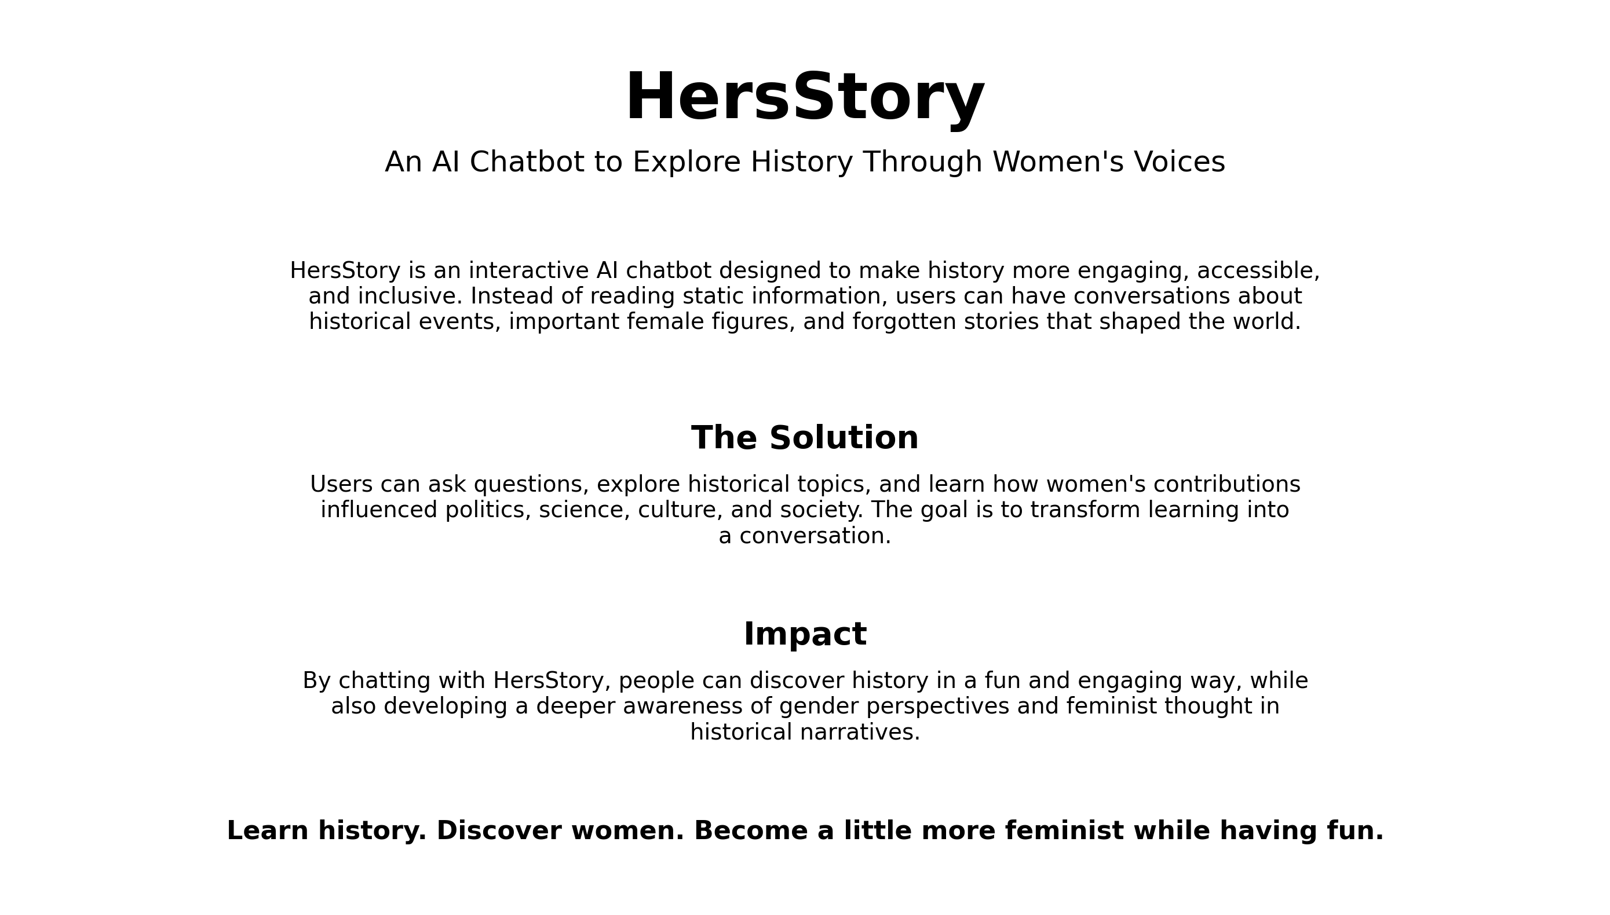

Slide 3
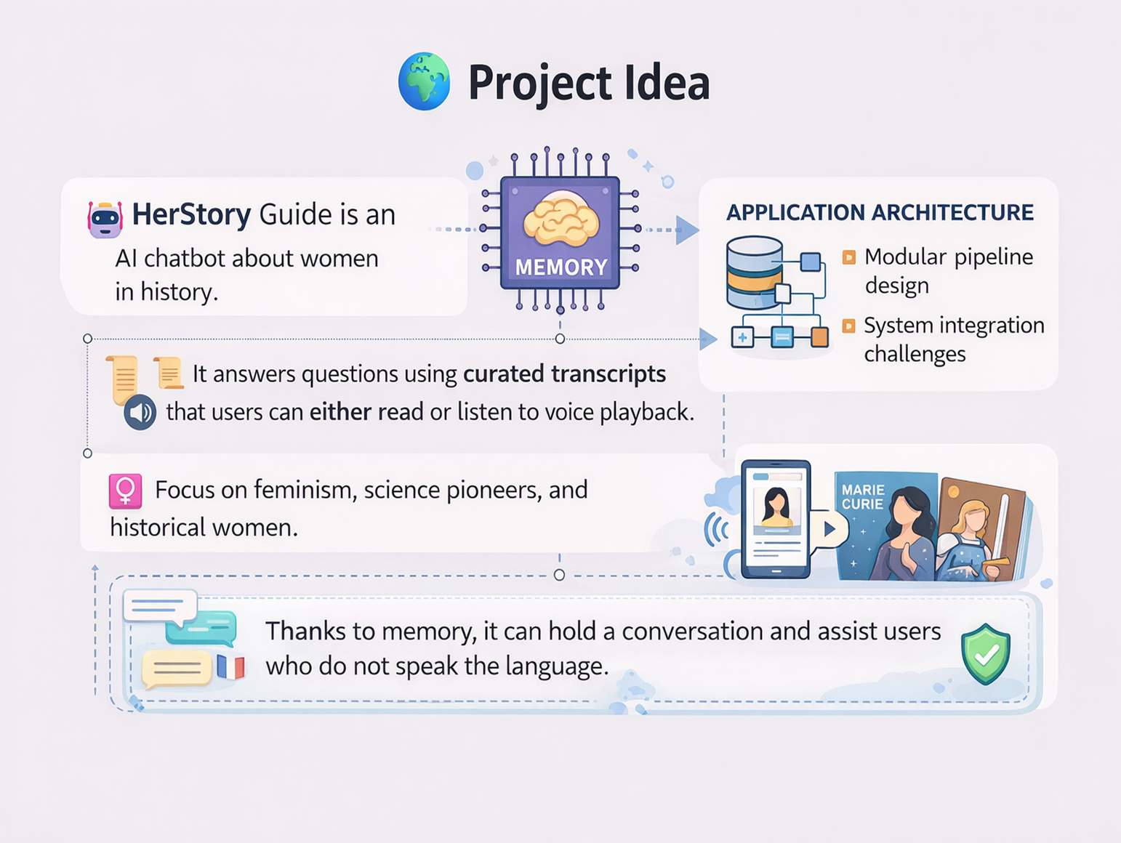

Slide 4
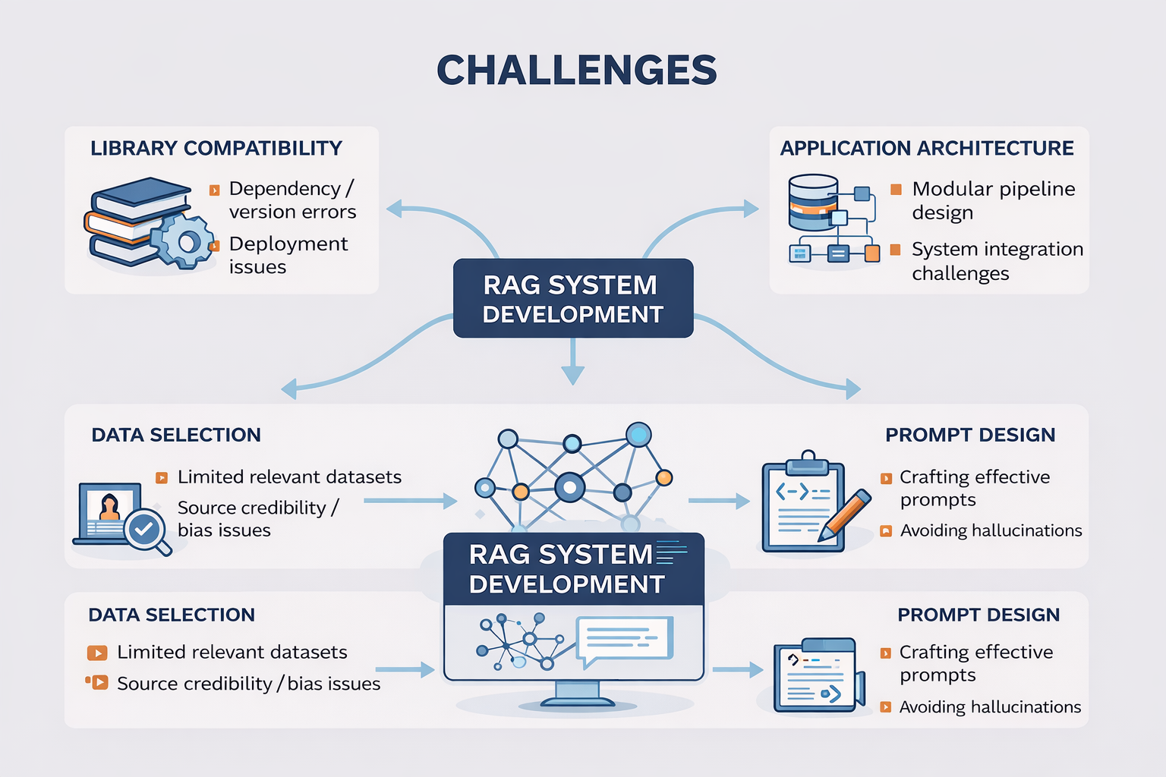
❗ The Problem

Slide 5

⚙️ RAG Pipeline
🎬 Video transcripts
🧹 Clean text
✂️ Chunking
🧠 Embeddings
📦 Vector DB
🔎 Retriever
🤖 LLM
Database consist of 9 videos
LLM: GPT-4o-mini (OpenAI)
Generates answers using retrieved transcript context
Supports multilingual prompts
Python + Regex
LangChain RecursiveCharacterTextSplitter
chunk size = 1000 characters
overlap = 200
MMR – Maximal Marginal Relevance
k = 8, fetch_k = 20
avoids retrieving very similar chunks
OpenAI Embeddings
ChromaDB
stores embeddings and enables similarity search

Slide 6
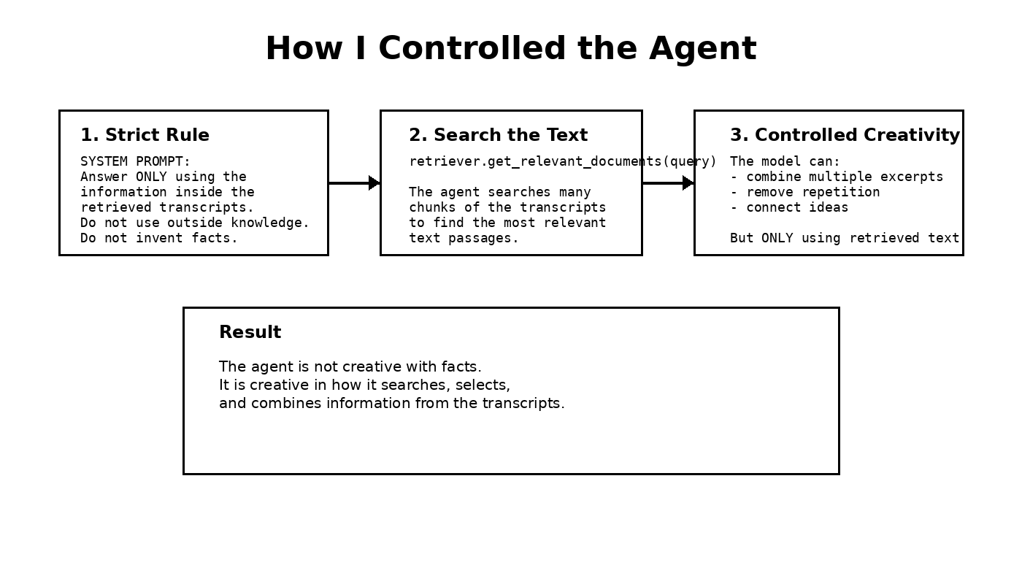

Slide 7
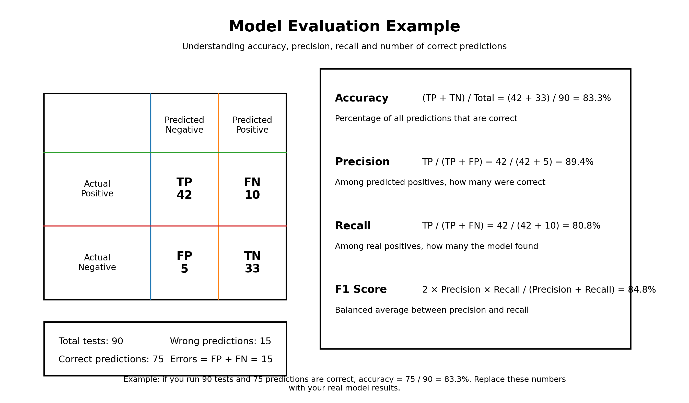

Slide 8
🚀 Future Improvements
📚 Add more historical datasets.
🎤 Add voice input.
🌐 Deploy online.

